Slide 1


Faculty of Computing and Informatics
Business Management Information Systems – BMC511S
Leeson 7 – Foundations of business intelligence

Slide 2
Faculty of Computing and Informatics
Introduction to information systems (IS) in organisations
An introduction to files
Challenges with the traditional file environment
Relational databases
Capabilities of databases and database management systems (DBMS)
Definition of business intelligence
Business intelligence infrastructure
Critical success factors to managing an organisation’s data resources

Slide 3
Faculty of Computing and Informatics
An introduction to files
Bit – the smallest unit of data a computer can handle
Byte – 8 bits represent a byte – which is the equivalent of a single character, i.e. a letter or a number
A word is a group of characters, e.g., a salary
A field is a group of words, e.g., employee name
A record is a group of related fields , e.g., employee name, employee number, etc.
A file is a group of records of the same type
Employee ID | Employee name | Department
1006789 | Dlodlo | Informatics
1002543 | Smith | Engineering
Employee records file

Slide 4
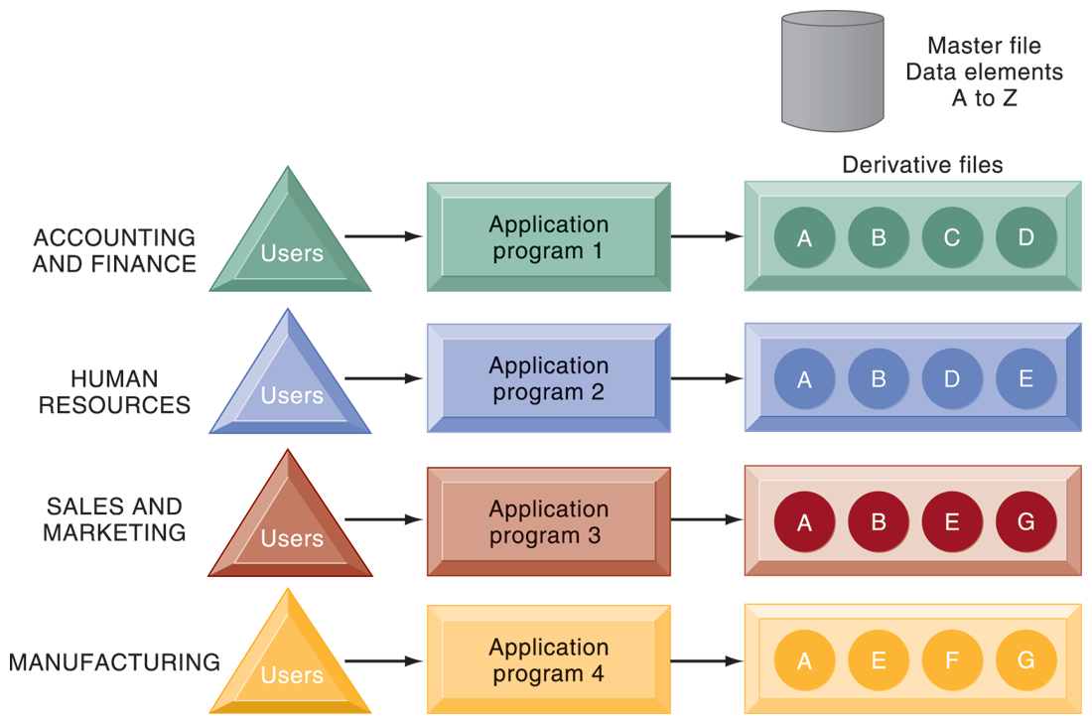
The use of a traditional approach to file processing encourages each functional area in a corporation to develop specialized applications. Each application requires a unique data file that is likely to be a subset of the master file. These subsets of the master file lead to data redundancy and inconsistency, processing inflexibility, and wasted storage resources.

Slide 5
Faculty of Computing and Informatics
Challenges with the traditional file environment
Data redundancy – duplication of data in multiple data files so that the same data are placed in more than one place or location in the organisation
Data inconsistency – the same attribute in different files has different values
Program-data dependence – the coupling of data stored in files and the specific programs required to update and maintain those files
Lack of flexibility – a traditional file can deliver routine schedule reports after extensive programming efforts, but it cannot deliver ad-hoc reports
Poor security – there is little control or management of data, meaning management have no way of knowing who is accessing or even making changes to the organisation’s data
Lack of data sharing and availability – If different pieces of information in different files and different parts of the organisation cannot be related to one another, it is impossible for information to be stored or accessed in a timely manner

Slide 6
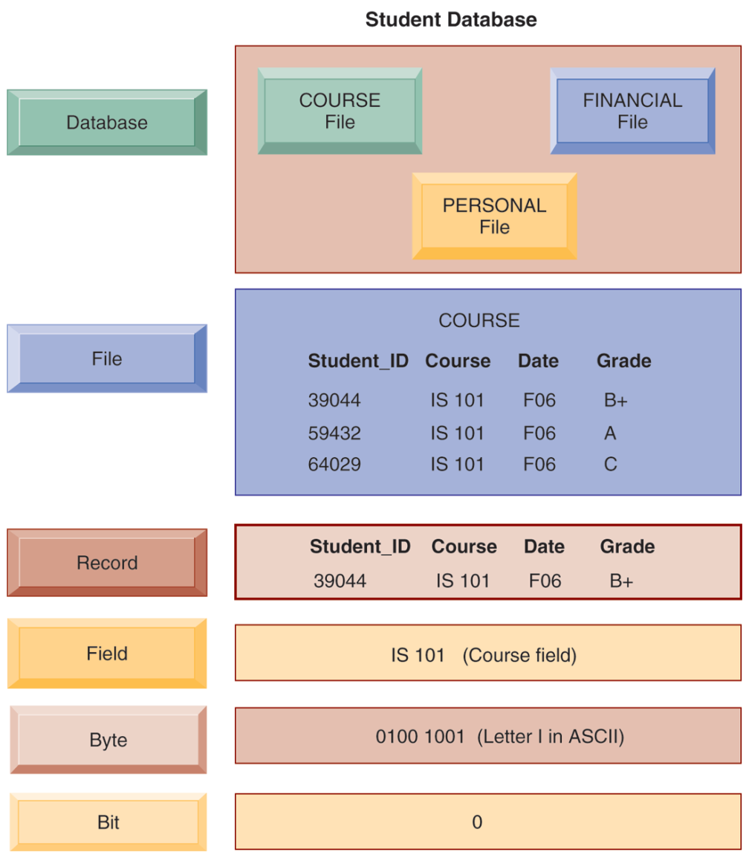
HIERARCHY OF DATA
Related records can be collected to form a file, and related files can be organized into a database.
Bits can be grouped to form a byte to represent one character, number, or symbol
A computer system organizes data in a hierarchy that starts with the bit, which represents either a 0 or a 1.

Slide 7
Faculty of Computing and Informatics
Relational databases
Relational databases represent data as two-dimensional tables called relations
The tables may also be referred to as files
Each table contains data on an entity and its attributes – it can be queried
Examples are Microsoft Access, DB2, Oracle Database, Microsoft SQL Server
Primary key
Supplier number | Supplier name | Supplier address
8259 | KOO | Windhoek
6372 | Heinz | Walvis Bay
5181 | Rainbow | Karasburg
Foreign key
Primary key
Grocery item | Item name | Price | Supplier name
137 | Baked beans | 9.80 | 8259
154 | Tomato Sauce | 18.00 | 6372
189 | chicken | 50.00 | 5181

Slide 8
Faculty of Computing and Informatics
Capabilities of Database Management Systems (DBMS)
A database is a collection of data organized to serve many applications efficiently by centralizing the data and controlling redundant data
A Database Management System (DBMS) is a software that permits an organisation to centralize data, manage them efficiently and provide access to the stored data by the application program, e.g. Oracle, MySQL, PostgreSQL, Microsoft SQL Server, MongoDB
The logical view of a database presents data as they would be perceived by end users or business specialists
The physical view of a database shows how data are actually organized and structured on physical storage media for querying and reporting

Slide 9
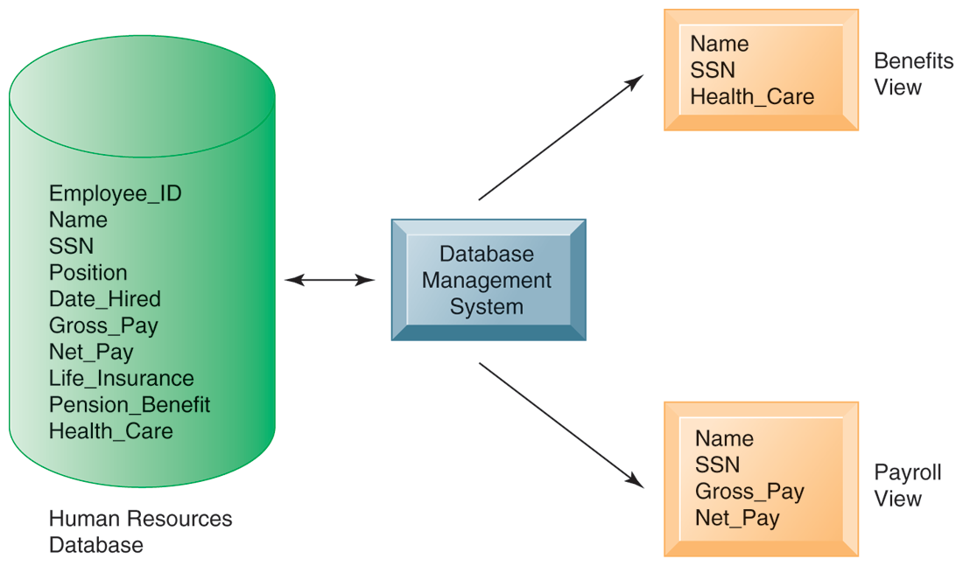
Faculty of Computing and Informatics
Capabilities of Database Management Systems (DBMS)

Slide 10
Faculty of Computing and Informatics
Definition of business intelligence – big data analytics
Business Intelligence is a technology-driven process for analyzing data and presenting actionable information to help Corporate Executives, Business Managers and other end users make more informed business decisions
Business intelligence is a term that refers to software applications used to analyse an organisation’s raw data
Business intelligence is technologies, applications and practices for the collection, integration, analysis and presentation of business information for better business decision-making
Business intelligence is made up of related activities including data mining, online analytic processing, querying and report
It provides concise, reliable information about the operations and trends in an organisation to help gain competitive advantage

Slide 11
Faculty of Computing and Informatics
Areas where business intelligence tools can be applied
Data mining
Web and ecommerce analytics
Querying, reporting and forecasting
Budget planning
Analyzing risks
Tracking performance and marketing campaigns
Analysis of geographic data

Slide 12
Faculty of Computing and Informatics
Business intelligence infrastructure
DATA WAREHOUSE: A data warehouse is a database that stores current and historical data of potential interest to decision-makers throughout the company. It extracts current and historical data from multiple operational systems in an organisation, combines with data from external data sources, restructures the data for management reporting and analysis before loading into the warehouse
DATA MART: A subset of a data warehouse in which a summarized or highly focused portion of the organisation’s data is placed in a separate database for a specific population of uses, e.g. a supermarket’s data mart can be – one for point of sale data; another for online sales
ONLINE ANALYTIC PROCESSING (OLAP): multidimensional data analysis that enables the users to view the same data in different ways using multiple dimensions

Slide 13
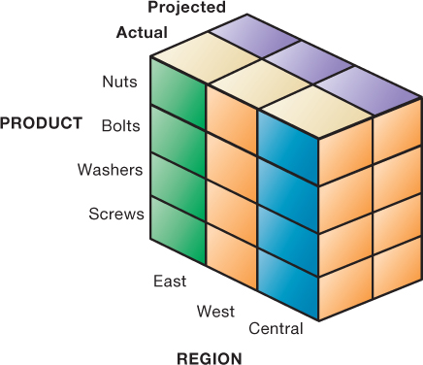
OLAP Supports multidimensional data analysis

Slide 14
Faculty of Computing and Informatics
Business intelligence infrastructure
DATA MINING: A discovery-driven method that finds hidden patterns and relationships in large databases and infers rules from them to predict future behaviour
TEXT MINING: Text mining tools extract key elements from unstructured big data sets (emails, memos, call centre transcripts, service reports), discover patterns and relations and summarise information
SENTIMENT ANALYSIS: software that is able to mine text comments in an email message, blogs, social media, conversation, or survey form to detect favourable and unfavourable opinions
WEB MINING: The web data is mined to reveal patterns, trends and insights into customer behaviour

Slide 15
Databases and the Web
Many companies use the web to make some internal databases available to customers or partners
Typical configuration includes:
  Web server
  Application server/middleware/C G I scripts
  Database server (hosting D B M S)
Advantages of using the web for database access:
  Ease of use of browser software
  Web interface requires few or no changes to database
  Inexpensive to add web interface to system

Slide 16
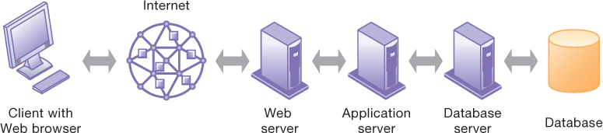
Linking Internal Databases to the Web

Slide 17
Faculty of Computing and Informatics
The critical success factors to managing an organisation’s data resources
Information policy: The organisation’s rules for sharing, disseminating, acquiring, standardizing, inventorying information, e.g., only HR and Finance have a right to view sensitive employee information
Data administration: The specific policies and procedures through which data can be managed as an organisational resource
Data governance: Policies and processes for managing the availability, usability, integrity and security of data employed in an enterprise, with special emphasis on promoting privacy, security of data, data quality and compliance with government regulations
Ensuring data quality: Data quality audit is a structured survey of the accuracy and level of completeness of data
Data cleansing (scrubbing): Activities for detecting and correcting data in a database that are incorrect, incomplete, improperly formatted or redundant

Slide 18
13 Storch Street
Private Bag 13388
Windhoek
NAMIBIA
T: +264 61 207 2258
F: +264 61 207 9258
E: fci@nust.na
W: www.nust.na
Faculty of Computing and Informatics
Thank You.

